Slide 1
Regression Analysis
Logistic Regression
Nicoleta Serban, Ph.D.
Professor
Stewart School of Industrial and Systems Engineering
Classification

Slide 2

About This Lesson

Slide 3
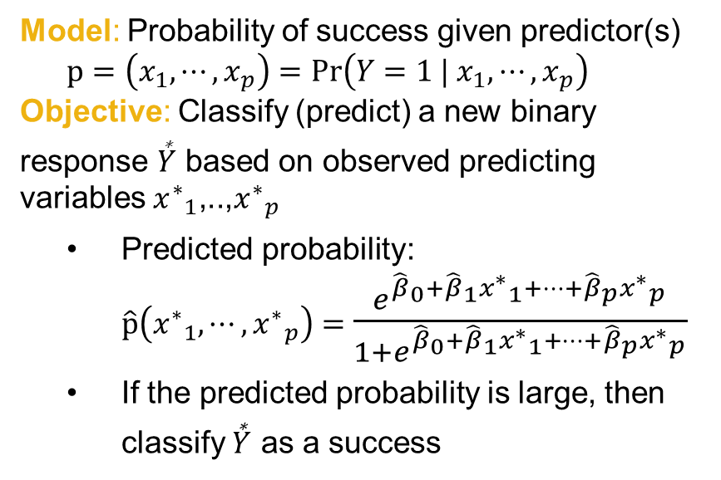
Classification Objective
Data:$\left\{\left(x_{1,1},x_{1,2},⋯,x_{1,p}\right),Y_{1}\right\}, ⋯,\left\{\left(x_{n,1},x_{n,2},⋯,x_{n,p}\right),Y_{n}\right\},$
w$here Y_{1},⋯,Y_{n} \text{are} \text{binary} \text{responses}$
Model: Probability of success given predictor(s)
$$p=\left(x_{1},⋯,x_{p}\right)=Pr\left(Y=1 |{ x}_{1},⋯,x_{p}\right)$$
Objective: Classify (predict) a new binary response $\overset{\text{∗}}{Y}$ based on observed predicting variables ${x^{∗}}_{1}\text{,..,} {x^{∗}}_{p}$
  Predicted probability:
$\hat{p}\left({x^{∗}}_{1},⋯,{x^{∗}}_{p}\right)=$ $\frac{e^{{\hat{β}}_{0}+{\hat{β}}_{1}{x^{∗}}_{1}+⋯+{\hat{β}}_{p}{x^{∗}}_{p}}}{1+e^{{\hat{β}}_{0}+{\hat{β}}_{1}{x^{∗}}_{1}+⋯+{\hat{β}}_{p}{x^{∗}}_{p}}}$
  If the predicted probability is large, then classify $\overset{\text{∗}}{Y}$ as a success

Slide 4
Classification Objective
Data:$\left\{\left(x_{1,1},x_{1,2},⋯,x_{1,p}\right),Y_{1}\right\}, ⋯,\left\{\left(x_{n,1},x_{n,2},⋯,x_{n,p}\right),Y_{n}\right\},$
w$here Y_{1},⋯,Y_{n} \text{are} \text{binary} \text{responses}$
Model: Probability of success given predictor(s)
$$p=\left(x_{1},⋯,x_{p}\right)=Pr\left(Y=1 |{ x}_{1},⋯,x_{p}\right)$$
Objective: Classify (predict) a new binary response $\overset{\text{∗}}{Y}$ based on observed predicting variables ${x^{∗}}_{1}\text{,..,} {x^{∗}}_{p}$
  Predicted probability:
$\hat{p}\left({x^{∗}}_{1},⋯,{x^{∗}}_{p}\right)=$ $\frac{e^{{\hat{β}}_{0}+{\hat{β}}_{1}{x^{∗}}_{1}+⋯+{\hat{β}}_{p}{x^{∗}}_{p}}}{1+e^{{\hat{β}}_{0}+{\hat{β}}_{1}{x^{∗}}_{1}+⋯+{\hat{β}}_{p}{x^{∗}}_{p}}}$
  If the predicted probability is large, then classify $\overset{\text{∗}}{Y}$ as a success
How good is the classification or prediction?
Goodness of fit doesn’t guarantee good prediction;
If we have many models for classification, how do we choose among them?

Slide 5
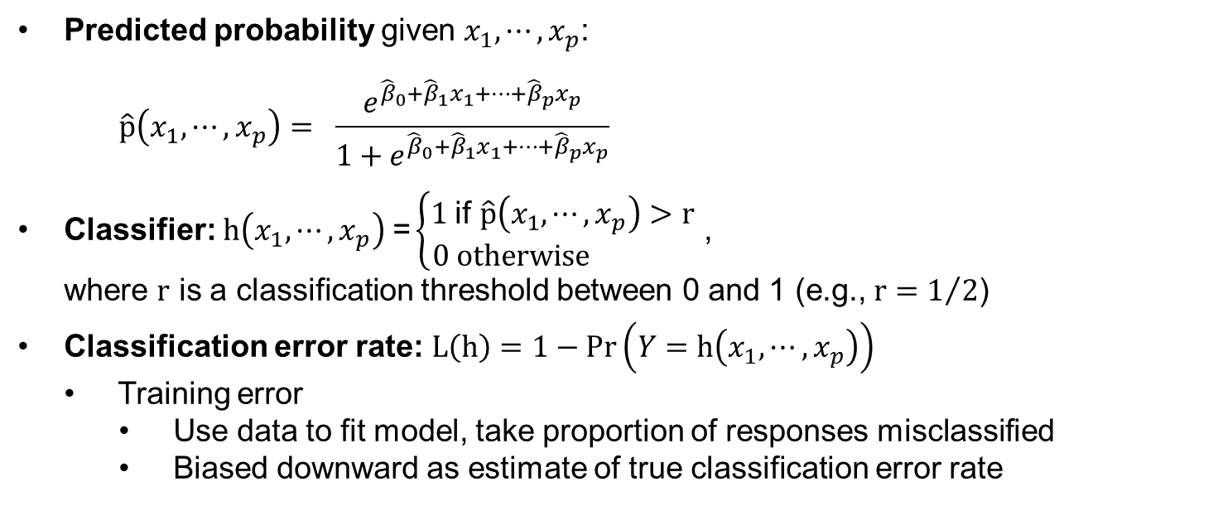
Classification Error Rate
Predicted probability given $x_{1},⋯,x_{p}$:
$$\hat{p}\left(x_{1},⋯,x_{p}\right)= \frac{e^{{\hat{β}}_{0}+{\hat{β}}_{1}x_{1}+⋯+{\hat{β}}_{p}x_{p}}}{1+e^{{\hat{β}}_{0}+{\hat{β}}_{1}x_{1}+⋯+{\hat{β}}_{p}x_{p}}}$$
Classifier: $h\left(x_{1},⋯,x_{p}\right) \text{=}\left\{\begin{matrix}1 \text{if} \hat{p}\left(x_{1},⋯,x_{p}\right)>r \\ 0 otherwise \end{matrix}\right.$ ,
where $r$ is a classification threshold between 0 and 1 (e.g., $r=1/2$)
Classification error rate: $L\left(h\right)=1−Pr\left(Y=h\left(x_{1},⋯,x_{p}\right)\right)$
  Training error
    Use data to fit model, take proportion of responses misclassified
    Biased downward as estimate of true classification error rate

Slide 6
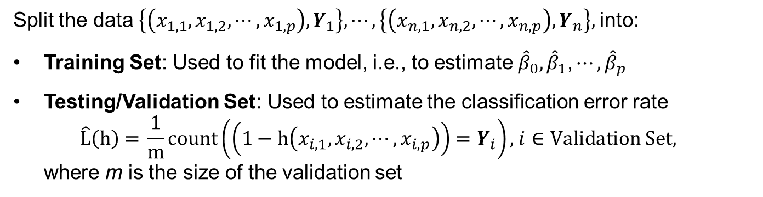
Cross-Validation
Split the data $\left\{\left(x_{1,1},x_{1,2},⋯,x_{1,p}\right),Y_{1}\right\}, ⋯,\left\{\left(x_{n,1},x_{n,2},⋯,x_{n,p}\right),Y_{n}\right\},$into:
Training Set: Used to fit the model, i.e., to estimate ${\hat{β}}_{0}, {\hat{β}}_{1}\text{,}⋯, {\hat{β}}_{p}$
Testing/Validation Set: Used to estimate the classification error rate
$$\hat{\text{L}}\left(\text{h}\right)\text{ = }\frac{\text{1}}{\text{m}}count\left(\left(1−\text{h}\left(x_{i,1},x_{i,2},⋯,x_{i,p}\right)\right)=Y_{i}\right)\text{, }i∈Validation Set,$$
where $\text{m}$ is the size of the validation set
How to split the data?
  Random subsampling
  k-fold cross-validation (KCV)
    Leave-one-out cross-validation (LOOCV)

Slide 7
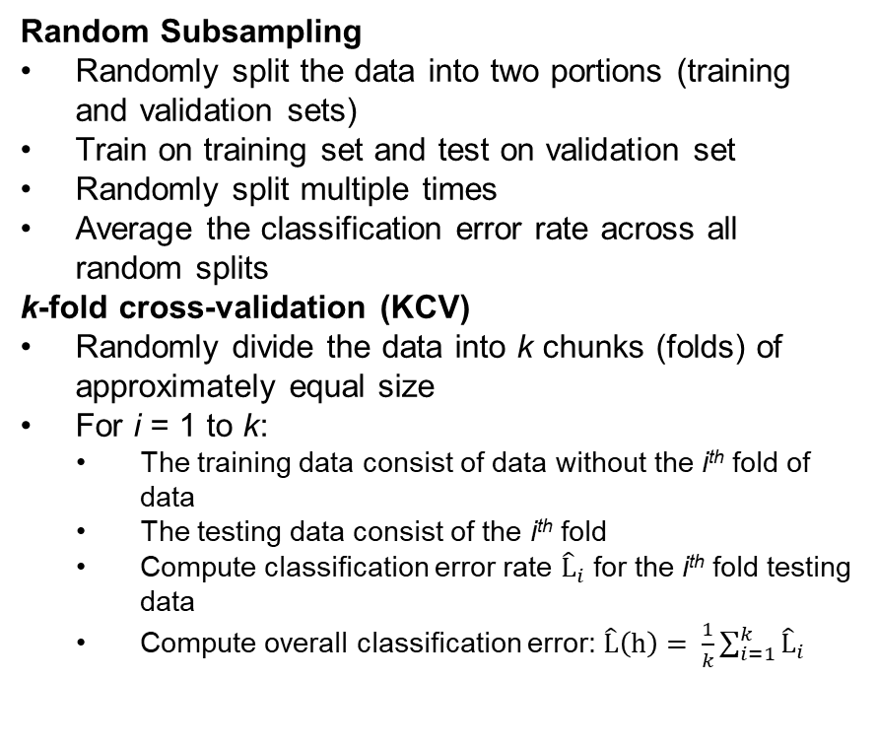
Cross-Validation: How to Split Data?
Random Subsampling
Randomly split the data into two portions (training and validation sets)
Train on training set and test on validation set
Randomly split multiple times
Average the classification error rate across all random splits
k-fold cross-validation (KCV)
Randomly divide the data into k chunks (folds) of approximately equal size
For i = 1 to k:
  The training data consist of data without the i^{th} fold of data
  The testing data consist of the i^{th} fold
  Compute classification error rate ${\hat{L}}_{i}$ for the i^{th} fold testing data
  Compute overall classification error: $\hat{L}\left(h\right)= \frac{1}{k}\sum_{i=1}^{k}{{\hat{L}}_{i}}$

Slide 8
Cross-Validation: How to Split Data?
Random Subsampling
Randomly split the data into two portions (training and validation sets)
Train on training set and test on validation set
Randomly split multiple times
Average the classification error rate across all random splits
k-fold cross-validation (KCV)
Randomly divide the data into k chunks (folds) of approximately equal size
For i = 1 to k:
  The training data consist of data without the i^{th} fold of data
  The testing data consist of the i^{th} fold
  Compute classification error rate ${\hat{L}}_{i}$ for the i^{th} fold testing data
  Compute overall classification error: $\hat{L}\left(h\right)= \frac{1}{k}\sum_{i=1}^{k}{{\hat{L}}_{i}}$
Random CV or k-fold CV?
Random subsampling is computationally more expensive than k-fold CV
How to choose k?
Leave-one-out CV is KCV with k = n
  Less computationally efficient than KCV
The larger the k, the less bias but the more variance

Slide 9

Summary

